Slide 1
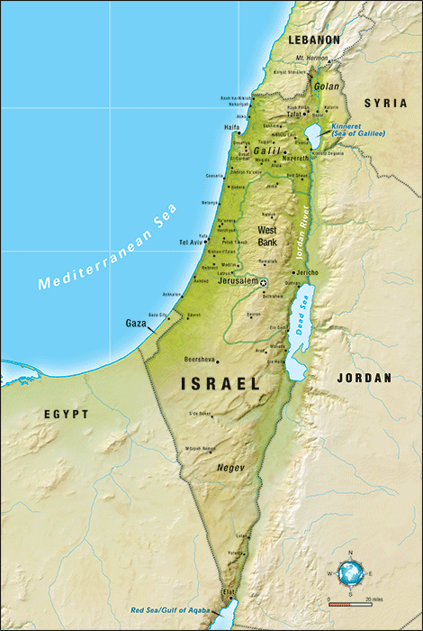
Gaza Perimeter Ninja Playgrounds

Slide 2
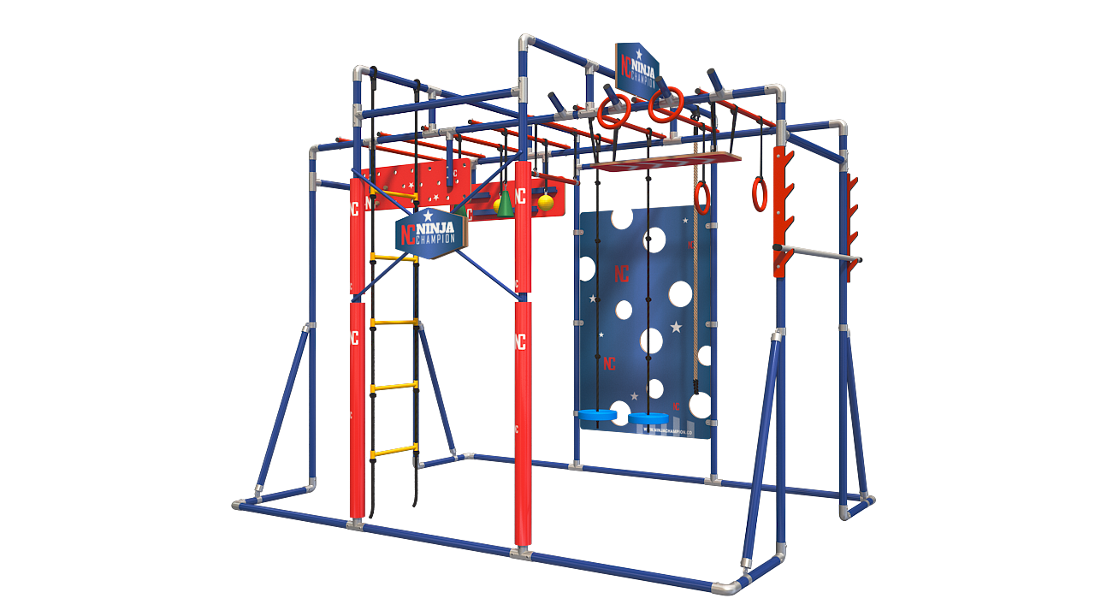
Background
The beauty of living in a Moshav or a Kibbutz is the freedom for kids to play outside close to nature, to take the dog for a long walk, and to spend the afternoons running around with their friends.
But the reality for the children that live in the area surrounding the Gaza strip is to live with ongoing daily stress. For the past 15 years, these children have grown up in a part of Israel that has been repeatedly bombarded by Palestinian rockets.
The ongoing stress causes sever psychological issues. Emotional anxiety, fear, depression, over-dependance on their parents, inability to potty-train, as well as other types of reactions that prevent these children from living a normal, happy childhood.
Ninja Champion is a small Israeli company established by 2 friends. They are both product designers by education, and a few years ago they had an idea to developed a playground system based on the very popular television show “Ninja Warrior”.

Slide 3
Their idea became a reality and a local (Israeli) company that today manufactures and installs Ninja Champion playgrounds across the country. The factory is located in Bat-Yam, on the outskirts of Tel-Aviv, Israel. Since the company started manufacturing, their ideas have developed into a true Israeli “start-up” company, employing Israeli men and women, working to create products to help Israeli children.
Since the beginning of this venture, they have received overwhelming positive feedback from customers who love their playground systems. Their products have become a daily activity for their customers’ children, enabling them to get out of the house, exercise, challenge themselves, and help develop strong, independent, confident children.
The Ninja Champion playground systems are not typical playgrounds. With the Ninja Champion playground, children challenge themselves to complete tasks, compete with friends, and try new things. The Ninja playgrounds don’t get “old” because there is always a new challenge to complete, and an old time-record to beat.

Slide 4
After the latest round of fighting between Israel and Hamas, Ninja Champion decided to offer to install 3 playground units of their largest model, the “Hurricane” in 3 communities for the benefit of the children that
Just had to endure the trauma of the latest round of fighting. They knew that offering their playgrounds to these communities would help those children. Not only physically, but also, and maybe more importantly, emotionally.
At first, they published a Facebook post asking people to nominate their community for the drawing of the Hurricane. What happened then was truly incredible. Within a day, over 43,000 people viewed the Facebook post, and HUNDREDS responded to it, nominating over 50 different communities around the Gaza border. The parents of the children living in those areas commented with emotional and painful messages that revealed their children’s suffering, and their feelings of helplessness in coping with the terrible effects of war on their children. Parents shared their stories of severe emotional distress, fears of leaving the house, using the toilet alone, of children sleeping in bed with their parents at night, and of their kids need for psychiatric drugs.
So, we have decided to set ourselves a goal to install our “Hurricane” model in all 50 of the communities that contacted us. We need to find a way and not let any of them down.

Slide 5
Michael Duvdevani, living in the United States heard about the offer to install 3 Hurricane units, and thought that the ninja playground is exactly what the children need. He made contact through Facebook, and together with Ninja Champion agreed that all the thousands of children living in all 50 of the settlements around the Gaza border would greatly benefit from having a unit in their community.
So, together we have decided to set ourselves a goal of installing the “Hurricane” model in all 50 of the communities.
The “Hurricane” system usually sells for 15,000 Shekels which is approximately $4,600. For this project, Ninja Champion will reduce their price to a level that just barely covers their expenses. They will manufacture and install these 50 units for just 11,340 Shekels each, which is $3,500 per unit. This price includes all taxes, and installation fees. The total cost for this project is just under $175,000.
One single person does not need to take on the cost of the entire project. We are a community, and we will work as such to raise the money, and make this dream come true. Some of us can only afford to contribute the funds for one unit, while other may be able to contribute for more. But together, we will accomplish this.

Slide 6
When we are done installing 50 of these units in Jewish communities around the Gaza border, it will have affected the lives of THOUSANDS of Israeli children. The funds raised for this project will go directly into the manufacturing and installation of the playgrounds. There are no “middle-man” organizations, and therefore none of the funds will be used for anything but purchasing and installing the ninja playgrounds.
THANK YOU for your consideration. We hope that together with you, we will be able to accomplish this project and announce that we will not only be giving 3 units, but that we will install one unit for all 50 communities.

Slide 7
Settlement List
Alumim
Ami Oz
Avshalom
Be'eri
Bror Chail
Dekel
Ein Habsor
Ein Ha'Shlosha
Erez
Gareen Har-El (Tzohar Gimel)
Gevim
Gvar'am
Gvulot
Holit
Karmia
Kerem Shalom
Kfar Aza
Kfar Mimon
Kisufim
Magen
Mefalsim
Mivtachim
Nahal Oz
Nativ Ha'Asara
Nir Am
Nir Itzhak
Nir Oz
Nirim
Ohad
Or Ha'Ner
Pri Gan
Re'eim
Sa'ad
Sde Avraham
Sde Nitzan
Shlomit
Shokeda
Shuva
Sufa
Talmei Eliyahu
Talmei Yosef
Tkuma
Tzohar
Yachini
Yad Mordechai
Yated
Yesha
Yevul
Zikim
Zimrat

Slide 8
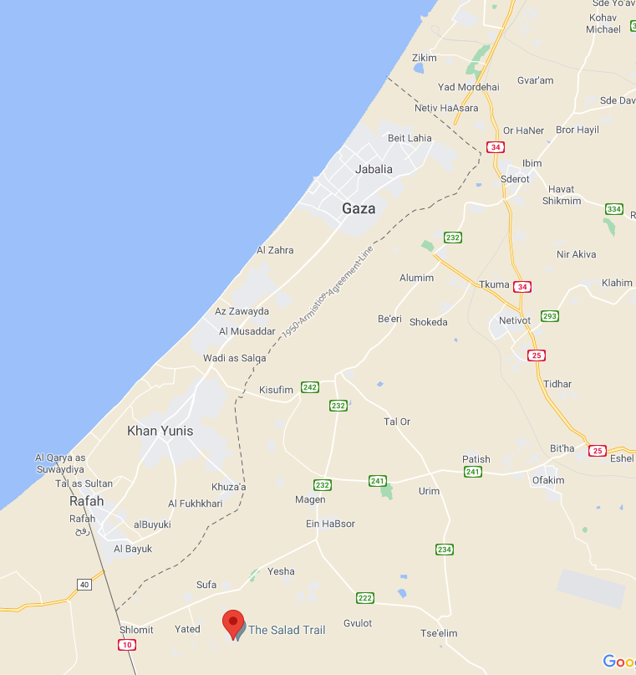

Slide 9
Video Illustration
15 challenges on each unit
Fire Rings
Monkey Bars
Olympic Rings
Solomon Ladder
Cheese Wall
Fly Board
Flying Discs
Hanging Cones
Bungee Grip
Rope Ladder
Peg Board
Iron-Finger Board
Yellow Grip-Balls
Swing Bar
Press “Play” to start video

Slide 10
So, let’s do it!
Your contribution to this project is tax deductible.
Once we receive your contribution, we will execute a purchase order with Ninja Champion, and designate the
settlements to receive your playgrounds.
We will coordinate with the settlements and decide on the public location within the communities for the
installation of your playgrounds.
Installation of your playground units will generally be completed within 14 days.
100% of your funds will be used towards the purchasing & installation of the ninja playgrounds. There are
no hidden costs, and no “administrative” expenses.

Slide 11
Contact
USA
Michael Duvdevani
205-222-9300
Michael@CompleteFeetUSA.com
Israel
Ilan Asulin
+972-54-730-0666
Info@NinjaChampion.co.il

